Slide 1

From management-led to self-organised
Set vision
Select projects
Define
Monitor
Manage
Set vision
Suggest projects
Initiate process
PM
process
PM
manage
enable
PL
report
PL
collaborate
PC
PC
managed teams
self-organised teams

Slide 2
Pillars
SELF ORGANISED TEAMS
VISION
MISSION
GOAL
FRAMEWORK
WITH CLEAR BOUNDARIES
AUTHORITY
AUTONOMY
REFLECTION
COMMON INFRASTRUCTURE

Slide 3
From 0 to isolated success
0
time
delivered value
effort
passion

Slide 4






P

Slide 5





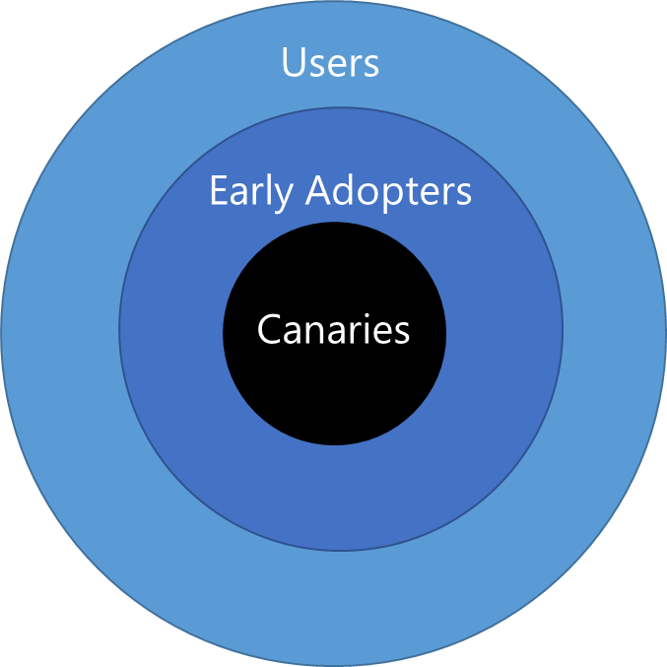
Team Services Pipeline with DEV, BETA, and PROD environments
Continuous Integration (CI)
Continuous Delivery (CD)
checkin
auto trigger
approval
approval
PIPELINE
❶
❷
❸
RINGS
Users
IMPACT RADIUS
Early Adopters
Canaries
PRODUCTION

Slide 6


ON
❷
Run-time query to determine flag value
if ( flag )
else
❸
OFF
❶
Feature Flag management service

Slide 7


Our evolution
aka.ms/wsbook3
aka.ms/wsbook4
Kanban +
Self-Organized
MSF
Scrum
Ruck (loose-Scrum)
2006
2009
2012
2015
2016
Rigid
2 PMs
200+ Rangers
5 Projects
0.5 PM
100 active Rangers
10 Projects
Rigid
Process
1.75h/WEEK
Process
Agile
Agile

Slide 8


